Slide 1
Services Data Provisioning
Anika Nower

Slide 2
Topics for Discussion
# | TOPICS
1 | SDP Team Profile
2 | What We Do
2 | Tools & Technologies
3 | Project Involvement
4 | Achievement
6 | Utilization
7 | Contribution & Suggestions

Slide 3
SDP Team Profile
Rounok
(7.8 yrs)
Muzahid
(2.6 yrs)
Afifa
(2.7 yrs)
Farzana
(3.2 yrs)
Aamir
(3 yrs)
Anika
(3.5 yrs)
Shimul
(2.6 yrs)
Taufiq
(2.3 yrs)
Experience Distribution
Key Activities
Periodically Data Refresh
Feed Deliveries with new development
Change Request Management
Data analysis and QA report generation
Country coverage : 40 (Approx)
Avg. Experience 3.5 yrs

Slide 4

My Project Work Flow
PROJECT HANDOVER
PRODUCTION
HANDOVER
PRODUCTION
CLIENT DELIVERY
QUALITY CHECK
DELIVERY
QC
HAND OVER PROCESS
IMS Health Confidential

Slide 5
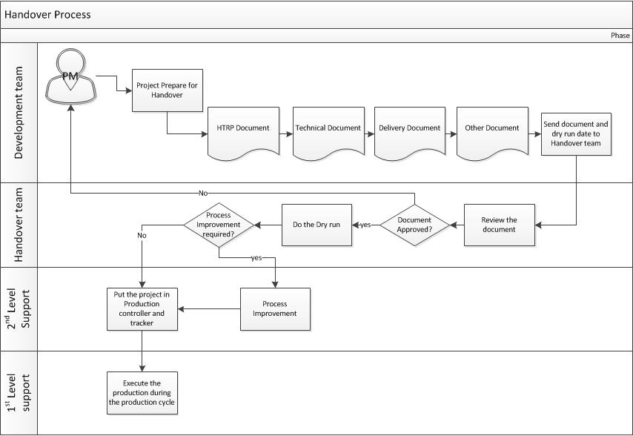
My Project Work Flow
PROJECT HANDOVER
PRODUCTION
HANDOVER
PRODUCTION
CLIENT DELIVERY
QUALITY CHECK
DELIVERY
QC
HANDOVER PROCESS
IMS Health Confidential

Slide 6

My Project Work Flow
PROJECT HANDOVER
PRODUCTION
HANDOVER
PRODUCTION
CLIENT DELIVERY
QUALITY CHECK
DELIVERY
QC
PRODUCTION
IMS Health Confidential

Slide 7
My Project Work Flow
SOURCE OF DATA:
LOCAL OFFICE
MIDAS DATA
PROJECT HANDOVER
PRODUCTION
HANDOVER
PRODUCTION
CLIENT DELIVERY
QUALITY CHECK
DELIVERY
QC
PRODUCTION
IMS Health Confidential

Slide 8
My Project Work Flow
INPUT TYPE:
CSV
EXCEL
DATA VIEW
CUBE
PROJECT HANDOVER
PRODUCTION
HANDOVER
PRODUCTION
CLIENT DELIVERY
QUALITY CHECK
DELIVERY
QC
PRODUCTION
IMS Health Confidential

Slide 9
My Project Work Flow
TYPE OF DELIVERABLES
PROJECT HANDOVER
PRODUCTION
Online Dashboard
Excel Dashboard
Flat File
Excel Report
HANDOVER
PRODUCTION
CLIENT DELIVERY
QUALITY CHECK
DELIVERY
QC
PRODUCTION
IMS Health Confidential

Slide 10
My Project Work Flow
WHAT WE DO
WHAT WE DO IN PRODUCTION
Data Production
Customize Feed Production
PROJECT HANDOVER
PRODUCTION
HANDOVER
PRODUCTION
CLIENT DELIVERY
QUALITY CHECK
DELIVERY
QC
PRODUCTION
IMS Health Confidential

Slide 11
My Project Work Flow
DEVELOPMENTS
OFFLINE DASHBOARD
DATA FEED
DATA VIEW GENERATION
PROCESS AUTOMATION
PROJECT HANDOVER
PRODUCTION
HANDOVER
PRODUCTION
CLIENT DELIVERY
QUALITY CHECK
DELIVERY
QC
PRODUCTION
IMS Health Confidential

Slide 12
My Project Work Flow
PROJECT HANDOVER
PRODUCTION
HANDOVER
PRODUCTION
CLIENT DELIVERY
QUALITY CHECK
DELIVERY
QC
QC
IMS Health Confidential

Slide 13
My Project Work Flow
PROJECT HANDOVER
PRODUCTION
WHY?
To maintain quality.
To check the proper delivery
To ensure zero error.
HANDOVER
PRODUCTION
CLIENT DELIVERY
QUALITY CHECK
DELIVERY
QC
QC
IMS Health Confidential

Slide 14
My Project Work Flow
PROJECT HANDOVER
PRODUCTION
HOW?
Input Vs output
Current Vs previous
Bridging alignment
Hierarchy check
Row count
Size check
Data Trend Analysis
Data Pattern
HANDOVER
PRODUCTION
CLIENT DELIVERY
QUALITY CHECK
DELIVERY
QC
QC
IMS Health Confidential

Slide 15
My Project Work Flow
PROJECT HANDOVER
PRODUCTION
HANDOVER
PRODUCTION
CLIENT DELIVERY
QUALITY CHECK
DELIVERY
QC
DELIVERY
IMS Health Confidential

Slide 16
My Project Work Flow
PROJECT HANDOVER
PRODUCTION
FREQUENCY
Quarterly
Monthly
Weekly
Yearly
HANDOVER
PRODUCTION
CLIENT DELIVERY
QUALITY CHECK
DELIVERY
QC
DELIVERY
IMS Health Confidential

Slide 17
My Project Work Flow
PROJECT HANDOVER
PRODUCTION
WAYS
DEPLOY CUBE
DASHBOARD DEPLOY
FILE EXPRESS
FTP
DROP OF TOOLS
HANDOVER
PRODUCTION
CLIENT DELIVERY
QUALITY CHECK
DELIVERY
QC
WHAT ELSE
IMS Health Confidential

Slide 18




Tools & Technology
MICROSOFT TECHNOLOGIES
REPORTING
DATABASE
DATA WAREHOUSE
.NET Framework
C#
Visual Basic
Web Services
SSIS
SSAS
Data quality services DQS
EXCEL
POWERPOINT
Microstrategy
SQL SERVER
MS ACCESS
IMS Health Confidential
My Knowledge & Expertise

Slide 19


Project Involvement
Current Project
Gilead
PFM
Life Scan
SPMSD
BI & GSK Austria
Mundi Pharma
Project Involvement
IMS Health Confidential

Slide 20
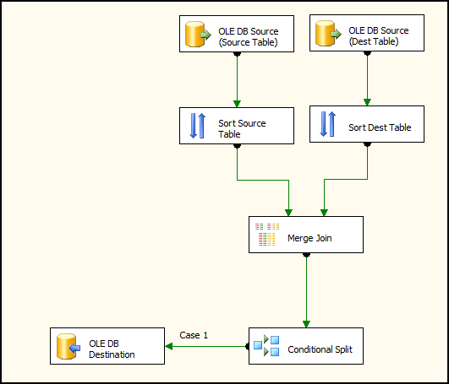
Project Involvement
Project Involvement
New Feed Integration/ Development
Deliverables:
Geo Dimension File
Product Dimension File
Fact File (sales File)
Input:
SA cube/IAM cube/Flat File/Data view File etc.
Used Technologies:
SQL, SSIS, Scripts.
QUALITY CHECK
SSIS Development

Slide 21
Project Involvement
Project Involvement
Change Request and Technical Solution
Change Request Handle
Business logic.
Change in Geography structures.
Change in Sales file (Exchange rate problem)
Many Others.
Provide technical solution to existing production system
Finding & providing solution to On Shore team.
If any change require in system.
Silly issues.

Slide 22
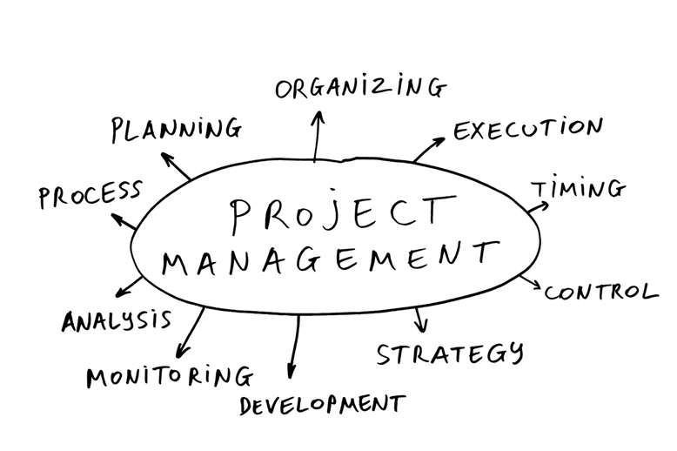
Achievement In Project

Slide 23

Achievement In Team
OVER 200+ DELIVERABLES
OVER 15+ SATISFIED CLIENTS
APPRECIATION FROM CLIENTS ANDONSHORE
NOTICEABLE REVENUE OF DHAKA IMS IS FROM TEAM SDP

Slide 24
Utilization
Utilization

Slide 25
Contribution & Suggestion In Team
Make Utilization 100%
Handle More projects
Arrange Technical Training

Slide 26
Thank you

